Slide 1

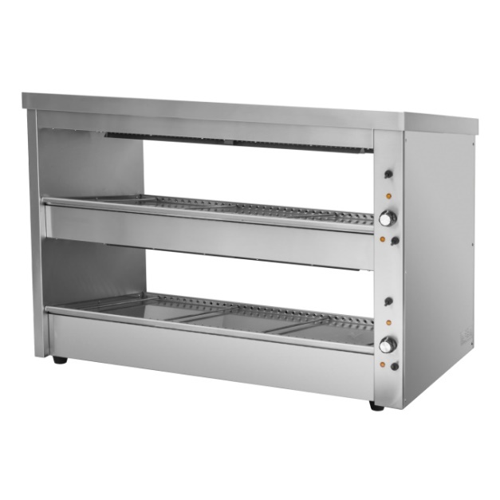
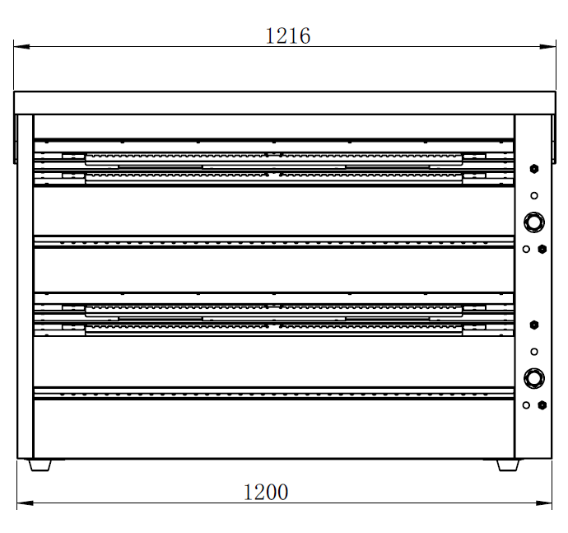
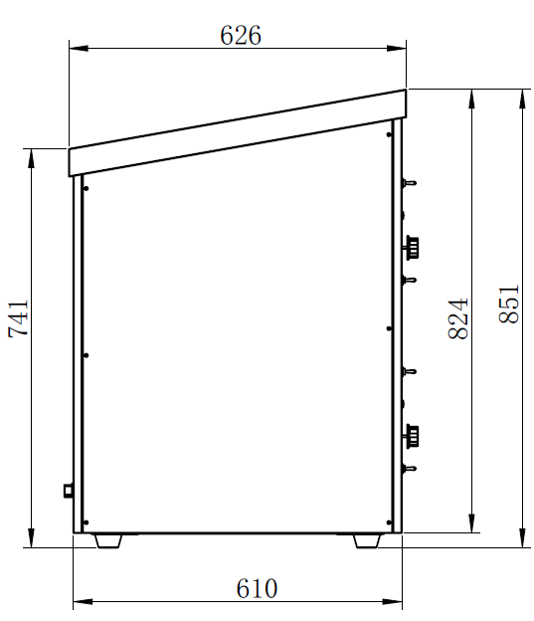

#
Merchandising Warmer
EHW-120
Dual Shelf Merchandising Display Warmer
Adjustable divider rods help food section display
Slant-design shelves for better merchandising
On/Off toggle switch for lights and heating
Temperature range 30~110 ℃
Heating indicator
High-temp resistant light
Available in different sizes
Anti-slip rubber feet
Model | Description | Power | Product (WxDxH) | Packing(WxDxH)
EHW-100 | Merchandising Warmer | 240V/ 2168W/10A | 1016x 626x 851 mm 40x 25x 33.5 inch | 1060x 670x 900 mm 42x 26x 35inch
EHW-120 | Merchandising Warmer | 240V/ 2168W/10A | 1216x 626x 851 mm 48x 25x 33.5 inch | 1260x 670x 900 mm 50x 26x 35inch
EHW-150 | Merchandising Warmer | 240V/ 2968W/15A | 1516x 626x 851 mm 60x 25x 33.5 inch | 1560x 670x 900 mm 61x 26x 35inch
EHW-180 | Merchandising Warmer | 240V/ 2968W/15A | 1816x 626x 851 mm 71.5x 25x 33.5 inch | 1860x 670x 900 mm 73x 26x 35inch

