Slide 1


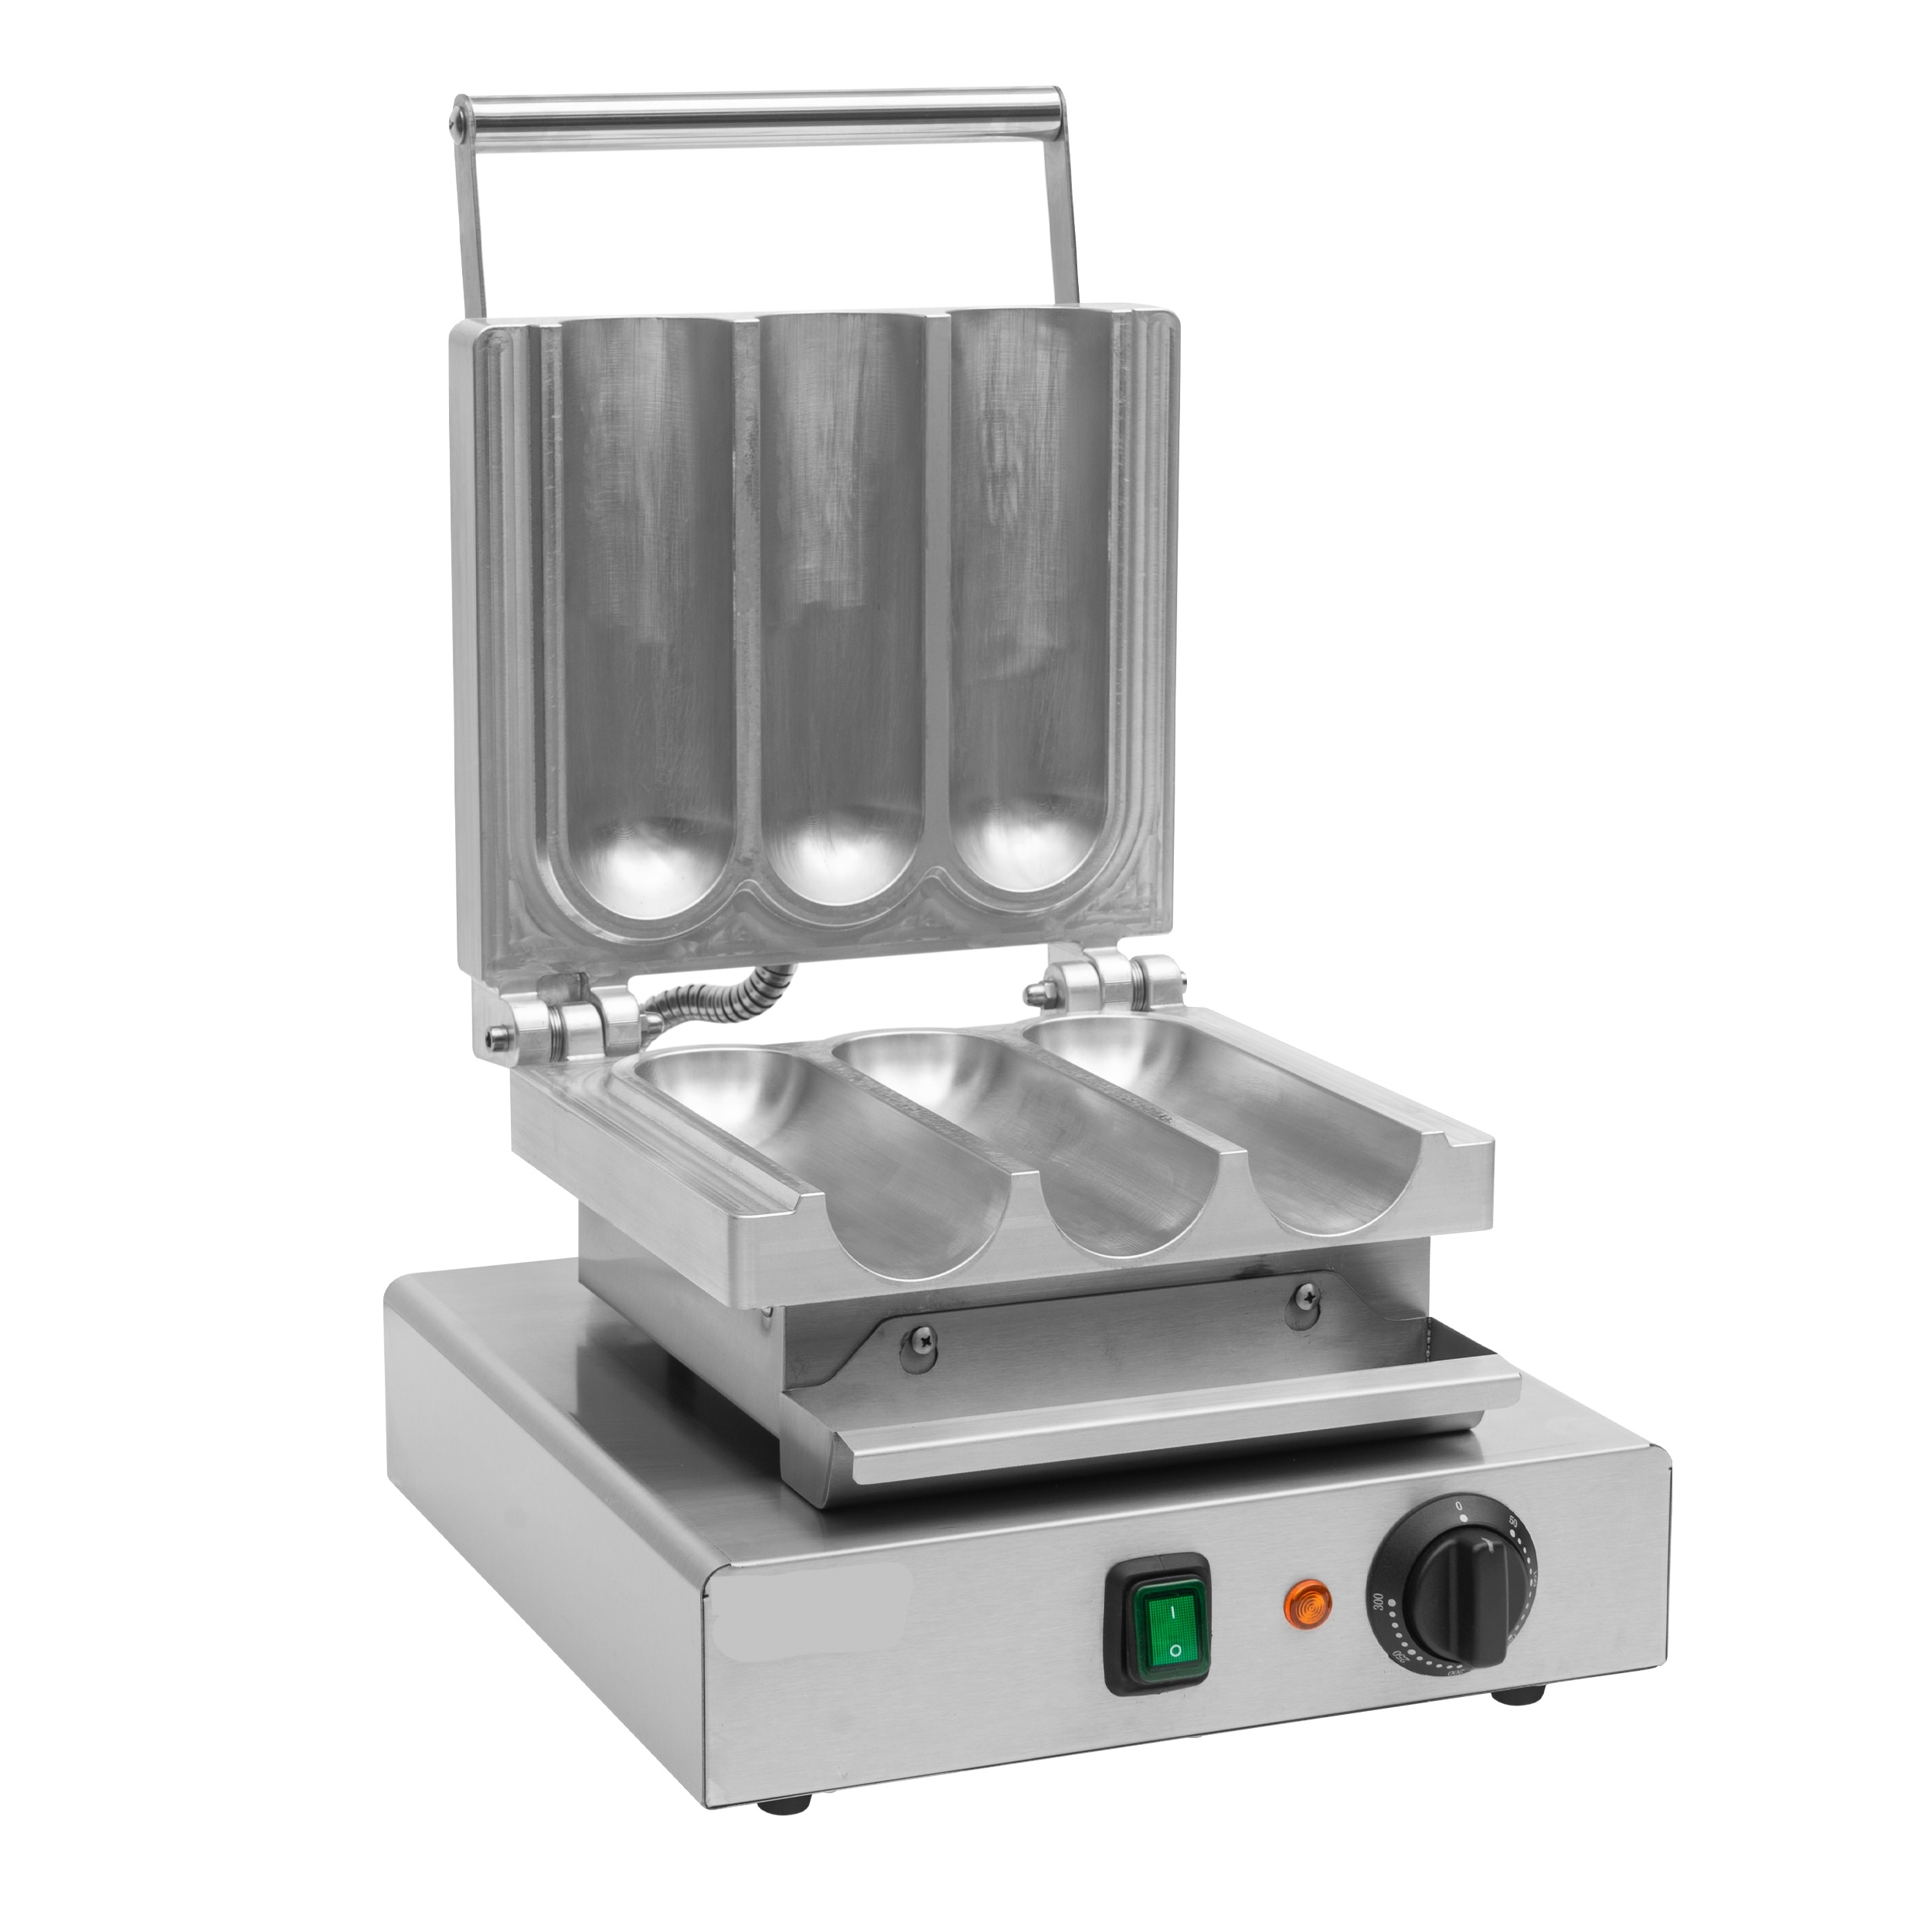
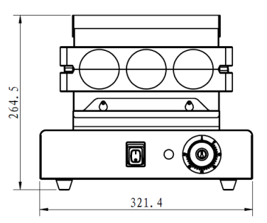
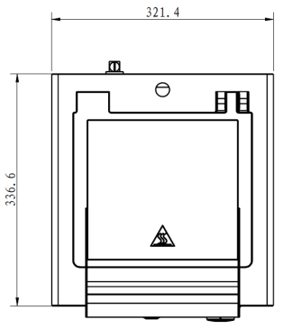
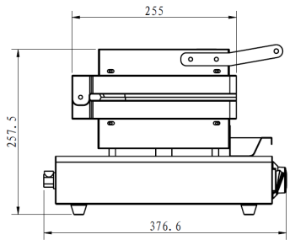
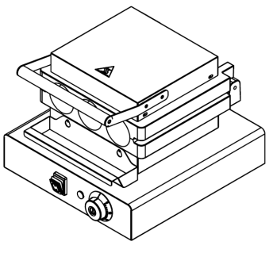

#
Chicken Roll Machine
EBM-3
Triple-cavity Chicken Roll Press Machine
Stainless steel construction
Press style operation for high efficiency
Triple-cavity cast aluminum molds
Simultaneous cooking of 3 chicken rolls
Thermostat control 50–300°C
Dual S/S 304 heating elements (upper & lower)
Power switch with heating indicator
Anti-slip rubber feet
Model | Voltage | Power | Temperature Range | Product (WxDxH) | Package (WxDxH)
EBM-3 | 240V | 1800 W | 50°C - 300°C | 321 x 377 x 258 mm 13x 15x 10 inch | 370x 425x 310mm 15x 17x 12 inch

