Slide 1


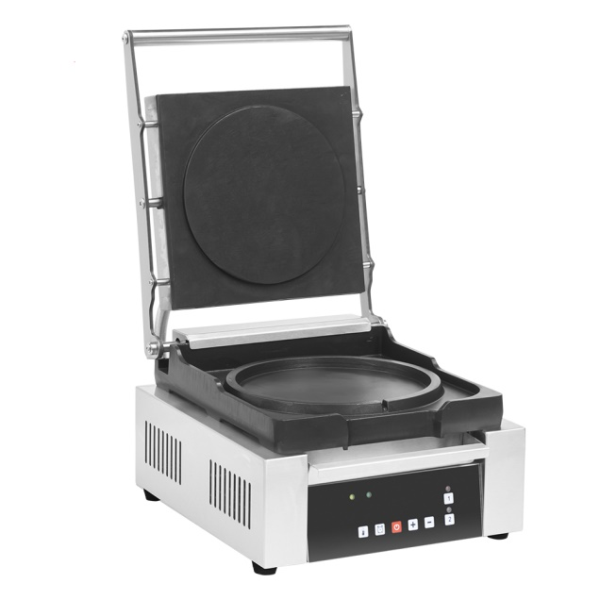
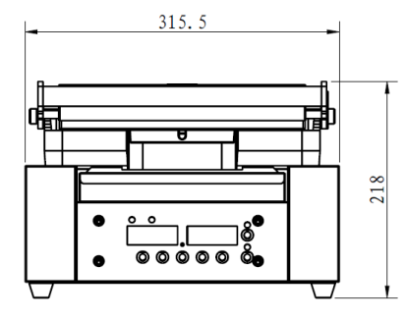
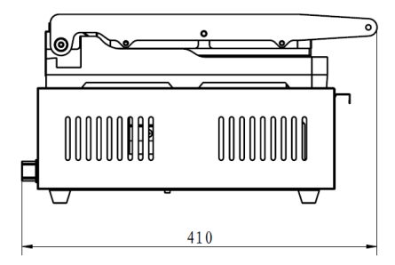
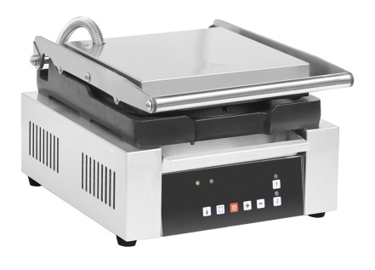

#
Omelet Maker
EOM-S
Multi-function Press Omelet Maker
Cast aluminum plate with anodized surface for fast, even heating
Press-type cooking system for omelettes, parathas, crepes and tortillas
8" (209 mm) lower circular mold
Temperature range 50°C – 220°C
Digital control for precise time and temperature settings
Two adjustable pre-set cooking times improve efficiency
S/S 304 heating element on upper and lower plates
Overflow design ensures uniform batter thickness
Easy access to reset rod
140°C manual reset safety thermostat
Cooling fan for control area
Top plate opens up to 90°
Anti-slip rubber feet
Model | Voltage | Power | Temperature Range | Product (WxDxH) | Package (WxDxH)
EOM-S | 240V | 1980 W | 50°C - 220°C | 316 x 410 x 218 mm 12x 16x 9 inch | 355x 470x 260 mm 14x 19x 10 inch

